Slide 1
Biology
Unit 3 Matter and Energy in Living Systems
Lesson 3: Modeling Matter and Energy in Ecosystems
Notes:
Lesson Objective: Explain, analyze, and model the flow of matter and energy through trophic levels using food chains, food webs, and pyramid models.

Slide 2

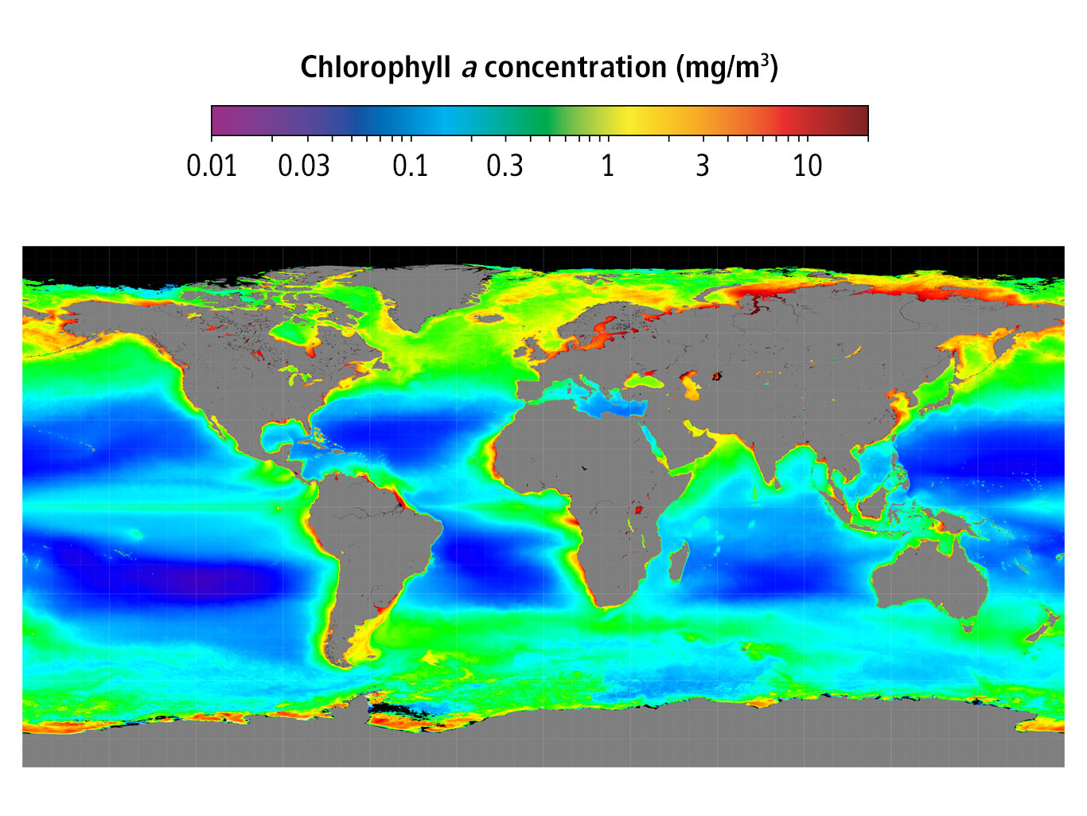
Can You Explain It?
Unit 3 Lesson 3
How might a decrease in the phytoplankton population affect the global flow of energy and matter?

Slide 3
Introduction to Ecosystems
Unit 3 Lesson 3
A population is a group of the same species that lives in the same area.
Multiple populations of different species form a community.
An ecosystem includes all of the biotic, or living, and abiotic, or nonliving, components in a given area.

Slide 4
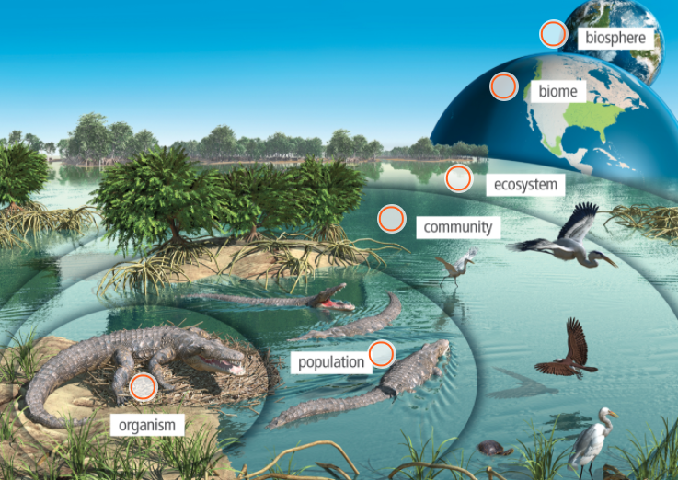
Introduction to Ecosystems
Unit 3 Lesson 3

Slide 5
Introduction to Ecosystems
Unit 3 Lesson 3
EXPLAIN
What biotic and abiotic components are found in the ecosystem where you live, and how do they interact?

Slide 6
Introduction to Ecosystems
Unit 3 Lesson 3
A biome is a major regional or global distribution of organisms adapted to living in that particular environment. At the largest scale, all life on Earth is part of the biosphere.
Biodiversity is a measure of the number of different species found within a specific area. An area with a high level of biodiversity, such as a tropical rain forest, has a large assortment of species living near one another.

Slide 7
Introduction to Ecosystems
Unit 3 Lesson 3
MODEL
Using your knowledge of photosynthesis, cellular respiration, and ecosystem structure, model how cutting down a tropical rain forest will affect surrounding biomes. Consider how the loss of the rain forest will affect the rate of photosynthesis in the area and how habitat loss will affect the rate of cellular respiration by animals in the forest. Then, model how the change in amounts of CO₂ and O₂ could affect surrounding ecosystems. What other ways might ecosystems be affected by such a loss?

Slide 8
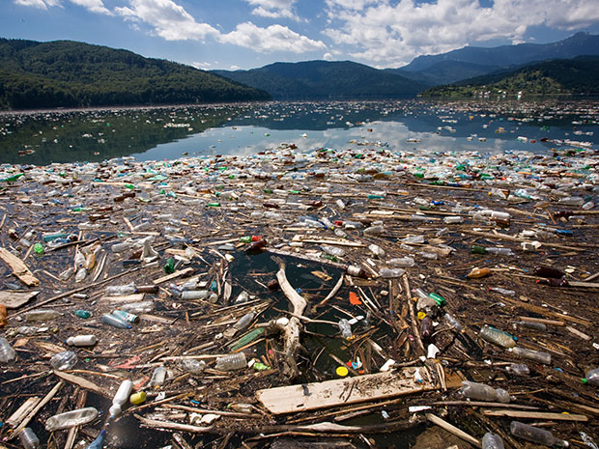
Introduction to Ecosystems Cause and Effect
Unit 3 Lesson 3
How do you impact your ecosystem?

Slide 9
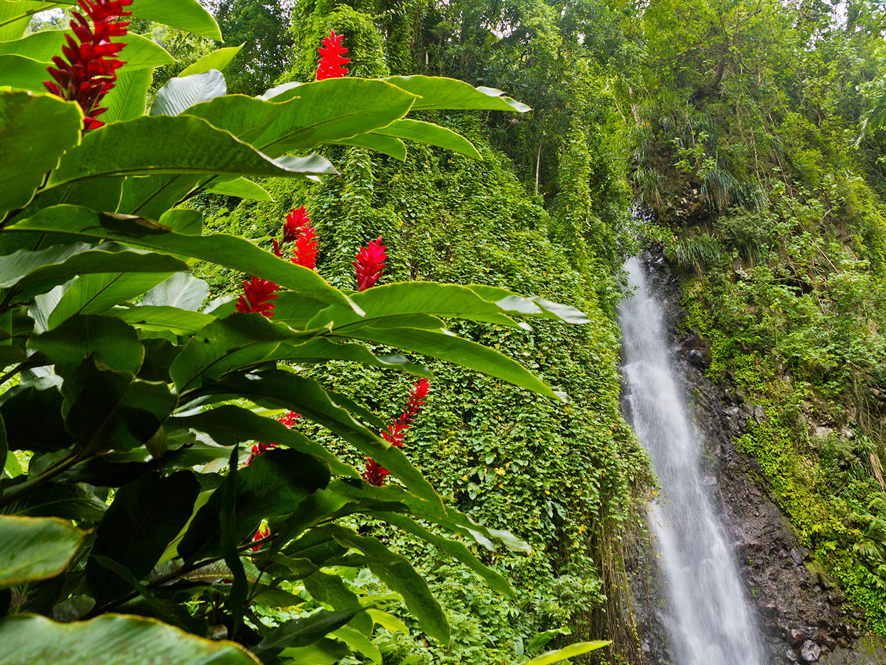
Energy and Matter Flow in Ecosystems
Unit 3 Lesson 3
All organisms need a source of energy to survive. Energy is essential for metabolism, which is all of the chemical processes that build up or break down materials in an organism's body.

Slide 10
Energy and Matter Flow in Ecosystems Energy and Matter
Unit 3 Lesson 3
MODEL
What is the relationship between energy and matter in the kingfisher?

Slide 11
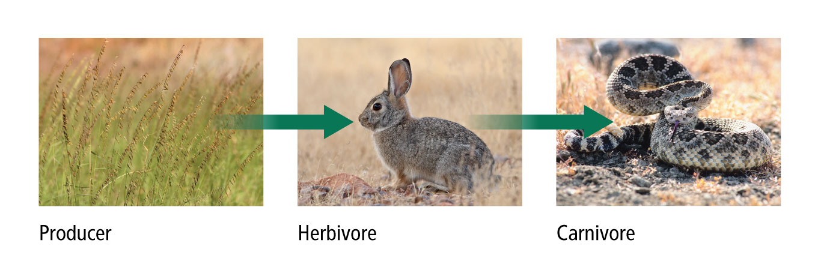
Energy and Matter Flow in Ecosystems
Unit 3 Lesson 3
A food chain is a sequence that links species by their feeding relationships.
Not all consumers are alike. Herbivores, such as desert cottontails, are organisms that eat only plants.

Slide 12
Energy and Matter Flow in Ecosystems
Unit 3 Lesson 3
MODEL
Draw a food chain that includes organisms in the area where you live. Identify the producers and consumers, and describe the flow of energy in the food chain.

Slide 13
Energy and Matter Flow in Ecosystems Systems and System Models
Unit 3 Lesson 3
Make a simple flow chart to illustrate how the organs of the digestive system interact to help you digest food.

Slide 14
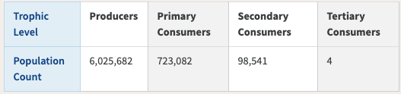
Energy and Matter Flow in Ecosystems Population Size
Unit 3 Lesson 4
How does the population amount change at each trophic level in this sample?
What is the relationship between trophic level and population size?
Predict what would happen if a quaternary consumer were added to this ecosystem.

Slide 15
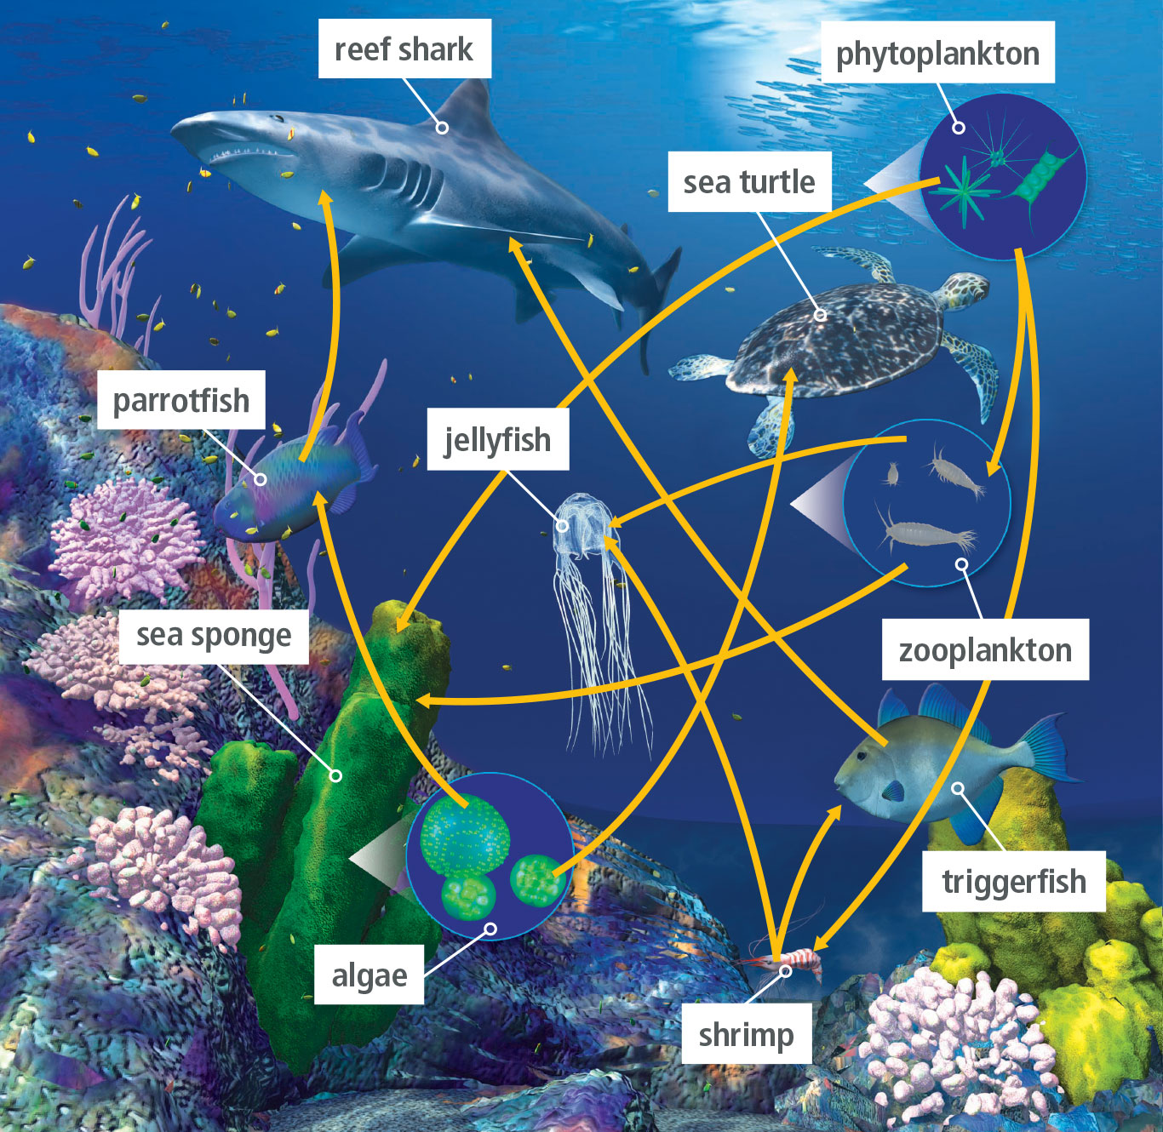
Energy and Matter Flow in Ecosystems
Unit 3 Lesson 4
A food web models the complex network of feeding relationships between trophic levels within an ecosystem.
A food web represents the flow of energy within and sometimes beyond the ecosystem.

Slide 16
Energy and Matter Flow in Ecosystems
Unit 3 Lesson 3
MODEL
Expand the food chain where you live to make a food web.

Slide 17
Energy and Matter Distribution in Ecosystems
Unit 3 Lesson 3
When a consumer eats food, the energy it contains undergoes a transformation.
Some is converted to new biomass, or growth. Of the remaining energy, some is released to the environment as heat, and the rest is excreted as waste.

Slide 18
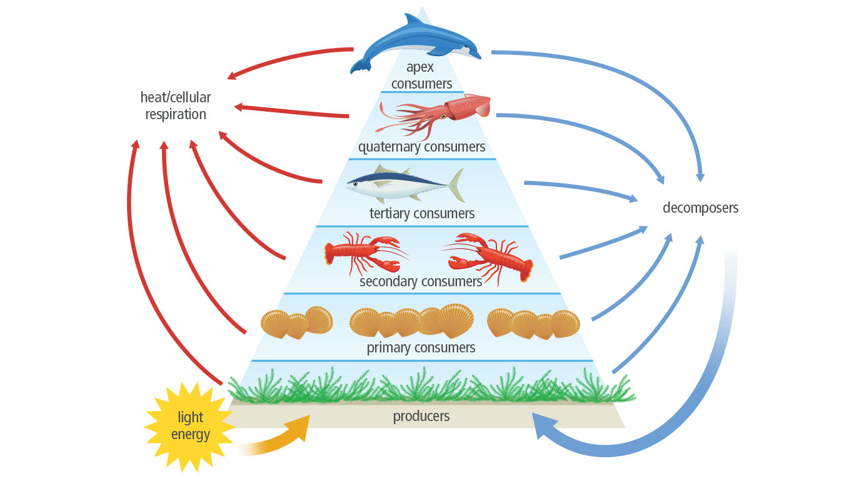
Energy and Matter Distribution in Ecosystems
Unit 3 Lesson 3

Slide 19
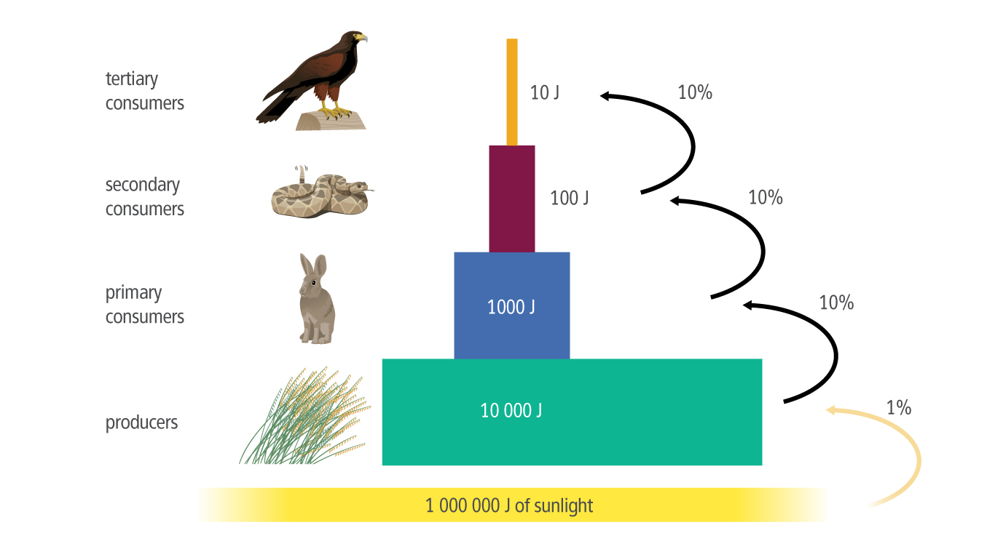
Energy and Matter Distribution in Ecosystems
Unit 3 Lesson 3
An energy pyramid models the transfer of energy beginning with producers and working up the food chain to the top-level consumer.
The pyramid illustrates how available energy is distributed among trophic levels in an ecosystem.

Slide 20
Energy and Matter Distribution in Ecosystems
Unit 3 Lesson 3
MODEL
Make a model that demonstrates the relationship between biomass and energy in an ecosystem.

Slide 21
Energy and Matter Distribution in Ecosystems
Unit 3 Lesson 3
A biomass pyramid compares the biomass at different trophic levels within an ecosystem.
A pyramid of numbers shows how many individual organisms are present at each trophic level in an ecosystem.

Slide 22
Can You Explain It?
Unit 3 Lesson 3
Refer to the notes in your Evidence Notebook to help you explain whether or not a robot fits the criteria of a living system. Consider the following questions when developing your explanation:
Explain the relationship between the phytoplankton population and chlorophyll concentration.
How can a decrease in the phytoplankton population affect life on Earth?
How might this change affect the flow of energy and matter in the biosphere?

Slide 23
Image Credits
Unit 3 Lesson 3
sideoats grass ©Patrick J. Alexander/U.S. Dept. of Agriculture USDA Photography Center; cottontail rabbit ©Robert Harding World Imagery/James Hager/Getty Images; average oceanic chlorophyll-a concentration Image courtesy of the ©SeaWiFS Project/NASA Goddard Space Flight Center; diamondback snake ©Getty Images; pollution in lake ©Alamy; tropical rainforest ©E+/oriredmouse/Getty Images

